Slide 1
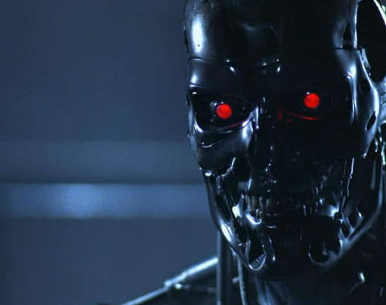
The Impact of AI in our Daily Lives
- Skylar York

Slide 2
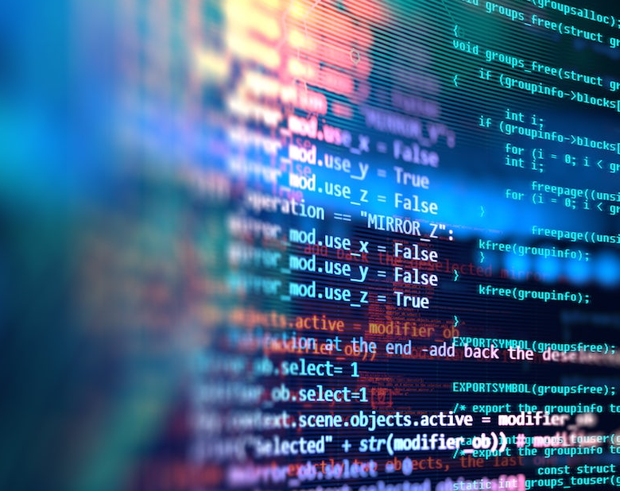
What is AI?
Simulation of human intelligence
How it works:
Gathers training data
Analyzes the data
Makes predictions
Can learn to generate lifelike exchanges or identify/describe images

Slide 3


Which one is the AI generated image and which one is a real person?

Slide 4
Answer: Left: real Right: AI generated
Notes:
The one on the left is Jensen Ackles known for playing Dean Winchester on Supernatural and Solider Boy on The Boys. The one on the right is AI generated. Notice how it’s difficult to distinguish between which one is real and which one isn’t. If you were surfing the Internet and saw two images of two people you didn’t know and had to pick which one was AI generated it would be difficult to figure out.

Slide 5

Why I believe it’s overused and dangerous
Recent drama
Security Risks
Misinformation
Hard to distinguish
Notes:
Recent drama:
2023 WGA strike
Security Risks:
As AI becomes more sophisticated the risks of their use and misuse increases allowing attackers to generated more advanced cyberattacks
Misinformation
AI generate content contributes to the spread of false information and manipulation of public opinion
Hard to distinguish
AI generated images make it difficult to know if someone’s real or not

Slide 6
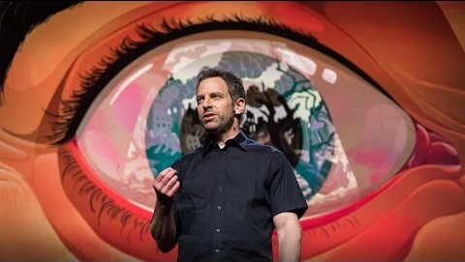
Professional opinion

Slide 7
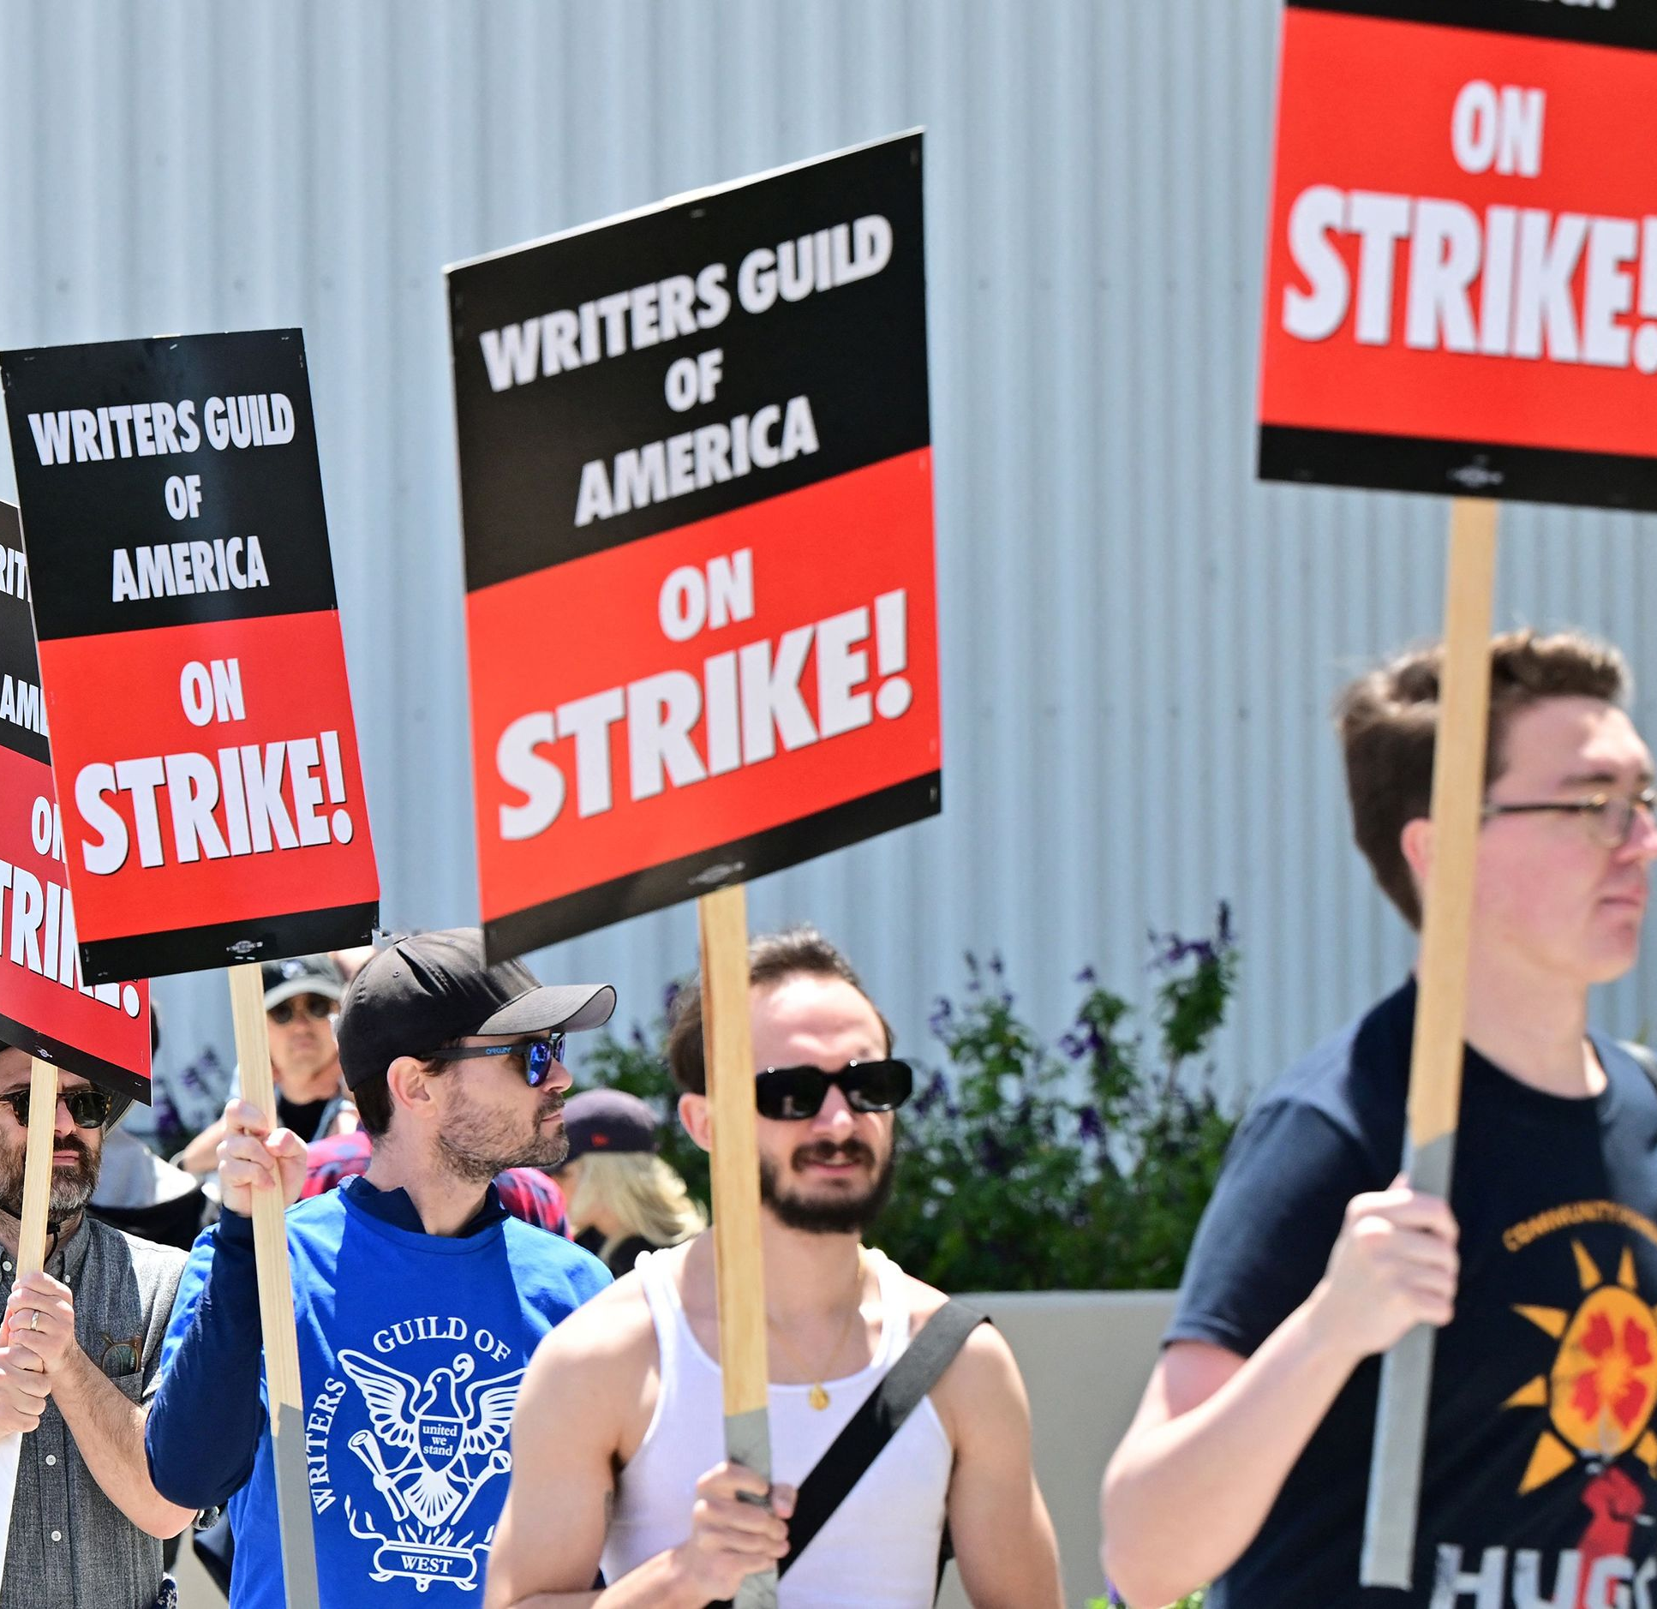
WGA 2023 Strikes
What happened?:
Unfair pay and AI disagreements
Results:
Studios made a deal
Notes:
What happened?:
Studios refused to not pay the writers what they deserve but the main issue was that they refused to agree to not produce AI-generated scripts and the WGA realized how serious studios were about using AI.
Results:
The WGA and studios agreed to pay the writers a fair wage but they also agreed that AI can’t be used to write or rewrite scripts and it can’t be considered as source material (which prevent writers from losing out on writing credits)

Slide 8
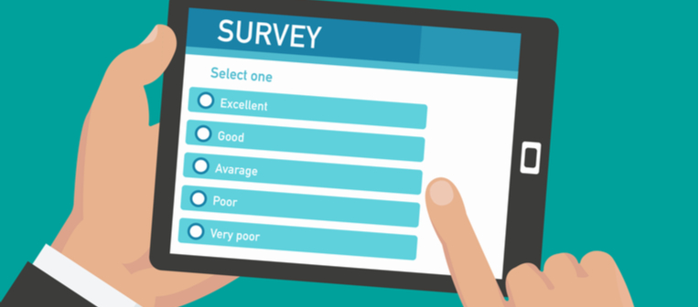
Survey Responses
Has AI made your job easier: Most people have found that it’s made their job easier.
Is it overused?: From the survey most people believe while AI is still in its infancy it is slowly starting to take over
How can we regulate it?: Have certain requirements and if those requirements are met then we can use AI.
How will AI change in the next 5 years?: AI will be widely used and used more in everyday life,
Notes:
Has AI made your job easier: Most people have found that it’s made their job easier while a few either don’t understand AI well enough or they don’t use AI at all
Is it overused?: From the survey most people believe while AI is still in its infancy it is slowly starting to take over
How can we regulate it?: From the survey most people believe we can regulate it by having certain requirements and if those requirements are met then we can use AI.
How will AI change in the next 5 years?: The general consensus was that AI will be widely used and used more in everyday life, but it could spell trouble for humanity. A couple of responses I would like to mention is one of the responses said that the respondent believes that “if left unchecked AI could spell big trouble for the cyber security field.”. The other response I would like to mention is a respondent believes that “in the next 5 years we could see AI taking peoples jobs.”

Slide 9
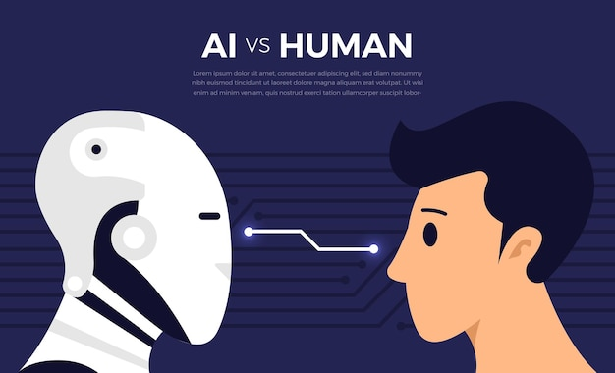
What will happen if we don’t regulate it
Job loss
Loss of Human interaction
Major Cyber attacks
Notes:
Job and Human interaction loss: According to the YouTube channel Food Theory (2024) Matt Patt theorizes about what the best ways to order food at fast food restaurants would be and how “later this year there will be a completely AI-ran restaurant Cali Express opening in Pasadena California”. This proves that AI has the risk of costing people their jobs and losing human interaction. Also, we’ve all had situations where sometimes when ordering at fast food restaurants it isn’t the best experience because the food is either missing something or completely wrong so if humans can’t get food right how will AI get food right.
Major Cyber attacks:
Attackers will be able to harness the power of AI to develop more advanced cyberattacks, bypass security measures, and exploit vulnerabilities in systems more easily

Slide 10
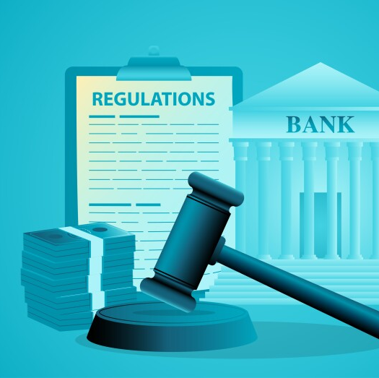
Regulations
Disclose that AI is being used
Limited access
AI monitoring tools
Notes:
Companies are legally required to disclose that AI is being used
EX: A hospital discloses to a patient in paperwork they must sign stating that they’re data will be handled by AI
Give AI only the access it needs to complete its task
Companies are legally required to set up barriers/alarms so that AI can be monitored and if it tries to do something it’s not supposed to the employees can stop it

Slide 11
References
Harris, S. & TED Talks. (2016, October 19). Can we build AI without losing control over it? | Sam Harris [Video]. YouTube. https://www.youtube.com/watch?v=8nt3edWLgIg
Laskowski, N., & Tucci, L. (n.d.). artificial intelligence (AI). Enterprise AI. https://www.techtarget.com/searchenterpriseai/definition/AI-Artificial-Intelligence
Li, V. (2023, June 14). What could AI regulation in the US look like? AmericanBarAssociation. https://www.americanbar.org/groups/journal/podcast/what-could-ai-regulation-in-the-us-look-like/
Marr, B. (2023, June 2). The 15 Biggest Risks Of Artificial Intelligence. Forbes; Forbes. https://www.forbes.com/sites/bernardmarr/2023/06/02/the-15-biggest-risks-of-artificial-intelligence/?sh=53891c412706
Merchant, B. (2023, September 25). Column: The writers’ strike was a victory for humans over AI - Los Angeles Times. Los Angeles Times. https://www.latimes.com/business/technology/story/2023-09-25/column-sag-aftra-strike-writers-victory-humans-over-ai#:~:text=Column%3A%20The%20writers'%20strike%20was%20the%20first%20workplace%20battle%20between,a%20line%20in%20the%20sand.
Olavsrud, T. (2023, September 22). 9 famous analytics and AI disasters. CIO. https://www.cio.com/article/190888/5-famous-analytics-and-ai-disasters.html
The Food Theorists. (2024, February 6). Food theory: STOP using the Drive-Thru! [Video]. YouTube. https://www.youtube.com/watch?v=LLIj3pXOKjs

